Slide 1

Fall 2025 Data 340 Data Mining
Final Project
Name:_____________________

Slide 2
Data Mining Methodology
Data Discovery and Exploration
Pre-Processing
Data Mining
Information Developement
Outcome Communication
Post-Processing
Methodologies are essential to consistent execution.
Having a plan to get to "AN" answer is better than no plan.

Slide 3
Each Data Mining Journey is unique
Data Discovery and Exploration | Specify the Question and scope the answer, Obtain the Data
Pre-Processing | Data Summaries (Categorical, Numeric), Identification and Summarization of Data Issues (Null, Missing, Corrutped values,etc.), Feature Selection, Dimensionality Reduction, Normalization, Data Subsetting
Data Mining | Resolving Data Issues, Performing Analysis
Post-Processing | Statistical Testing, Significance Testing, Sampling of Instances, Hypothesis Testing
Information Development | Analysis Outcomes, Data Review, Data Issue Summary,
Outcome Communication | Answering the Specific Questions, Report formation, and messaging
Here is the compass to keep you on track:
Plans the work
Gives direction within each step
Helps to document findings, actions taken
Allow notes to be taken as analysis progresses

Slide 4
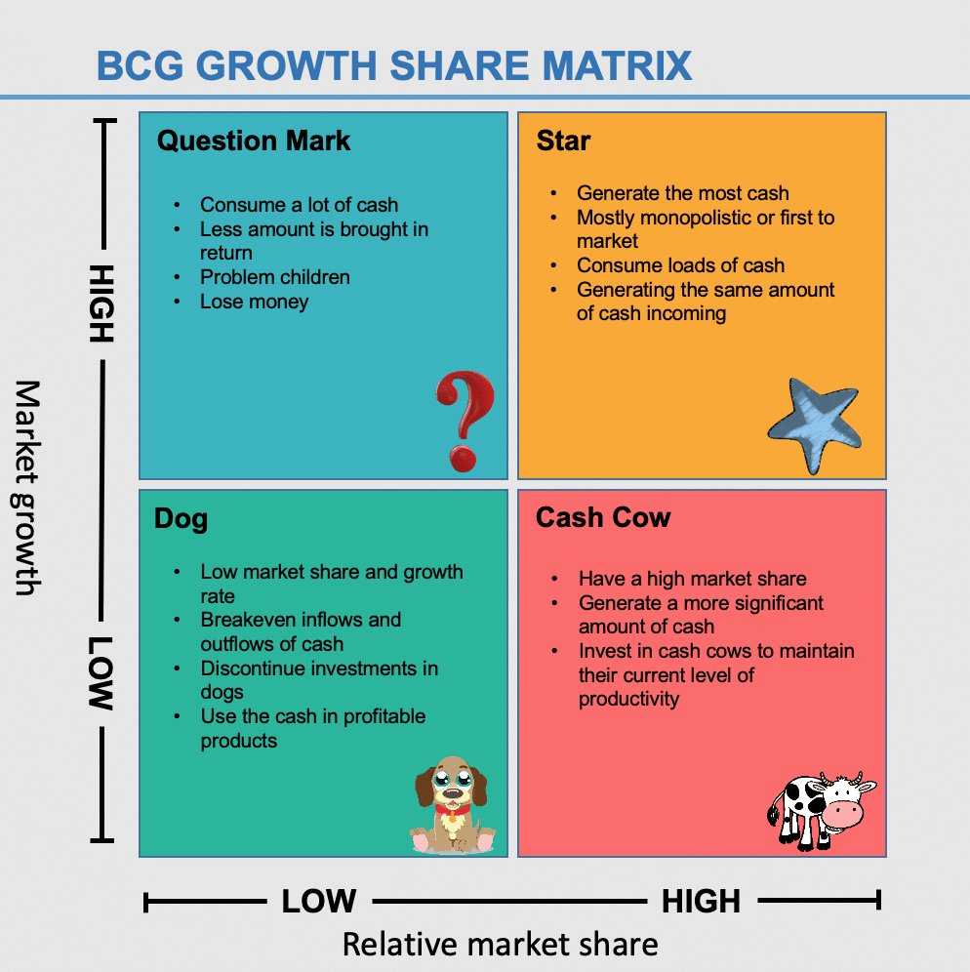
Boston Consulting Group: Share Growth Matrix
From:
BCG Growth Share Matrix | Make Wiser Investing Decisions - Business Strategy Hub

Slide 5
Data Discovery and Exploration
Using the Boston Consulting Group Growth Share Matrix Classifications which 16 companies (4 from each classification) would you advise investors to build a portfolio from the 60 company profiles provided?
Data Dictionary
Variables | Data Type
Company | Nominal
Industry | Nominal
BCG Group | Nominal
Revenue | Numerical
Profits | Numerical
Costs | Numerical
Customer Satisfaction Score | Numerical
Market Share | Numerical
Growth Potential | Numerical
Stock Price | Numerical
Specify the Question
Scope the answer
Obtain the Data
Create "your" Data Dictionary

Slide 6
Pre-Processing
The data provided is Quarterly Performance values for each company over 5 years (20 Quarters)
There are 10 distinct data mining issues in the data that need to be resolved
The data must be aggregated (using average) to the Annual level.
Customer Satisfaction, Revenue, Profit, Cost, and Stock Price will be labeled:
Low (<25th percentile)
Medium(>=25th and <=75th percentiles)
High(>75th percentile)
Market Share and Growth Potential will normalized using the ZScore Normalization
Data Subsetting will not be utilized
Data Summaries (Categorical, Numeric),
Identification and Summarization of Data Issues (Null, Missing, Corrutped values,etc.),
Feature Selection,
Dimensionality Reduction,
Normalization,
Data Subsetting

Slide 7
Data Mining
10 distinct data mining issues discovered and resolved
1 - Missing Industry Names
2 - Missing Revenue Values
3 - Missing Profit Values
4 - Missing Cost Values
5 - Satisfaction Score not normalized
6 - Market sgare % not normalized
7 - Growth Potental not normalized
8 - Missing Stock Price values
9 –phony company names deleted
10 –some companies had their name written 2 different ways
Resolving Data Issues
Performing Analysis

Slide 8
Post Processing
Much of the problems with this data set come from the decimal place errors, for this I employed a simple fix to move the decimal place over a couple units if the number was over a certain value. To find the missing stock price and revenue numbers I did the average of the rest of the respective revenues and stock prices for that company. Everything else could be calculated or figured out with the data that was given
Classification
Stock Price by Financials
Stock Price by Growth and Market share
Clustering – Company Clusters by BCG Factors
K-Means
DB SCAN
Hierarchical

Slide 9
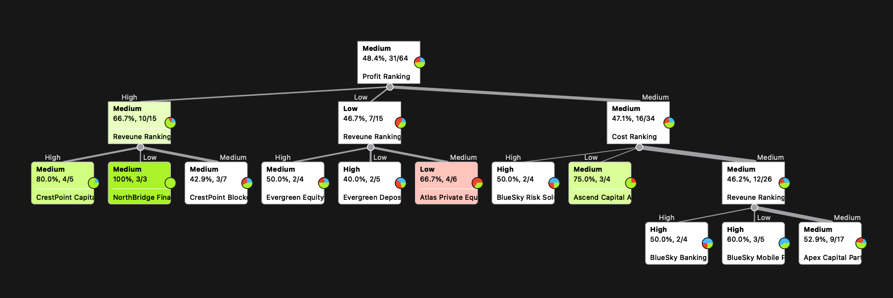
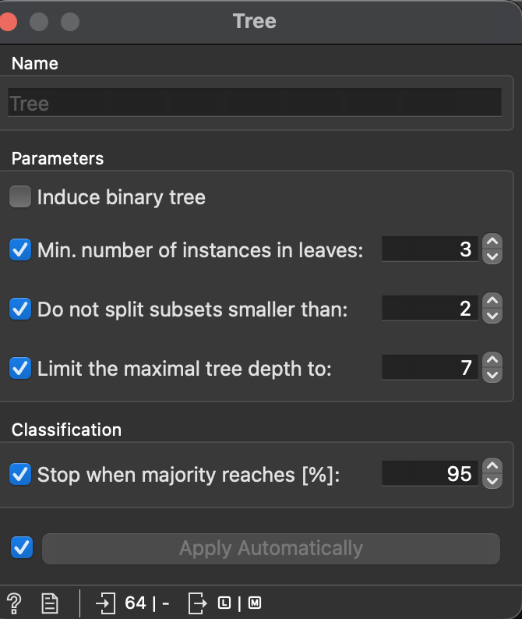
Classification - Stock Price by Financials
Classification Tree
Classification Settings

Slide 10
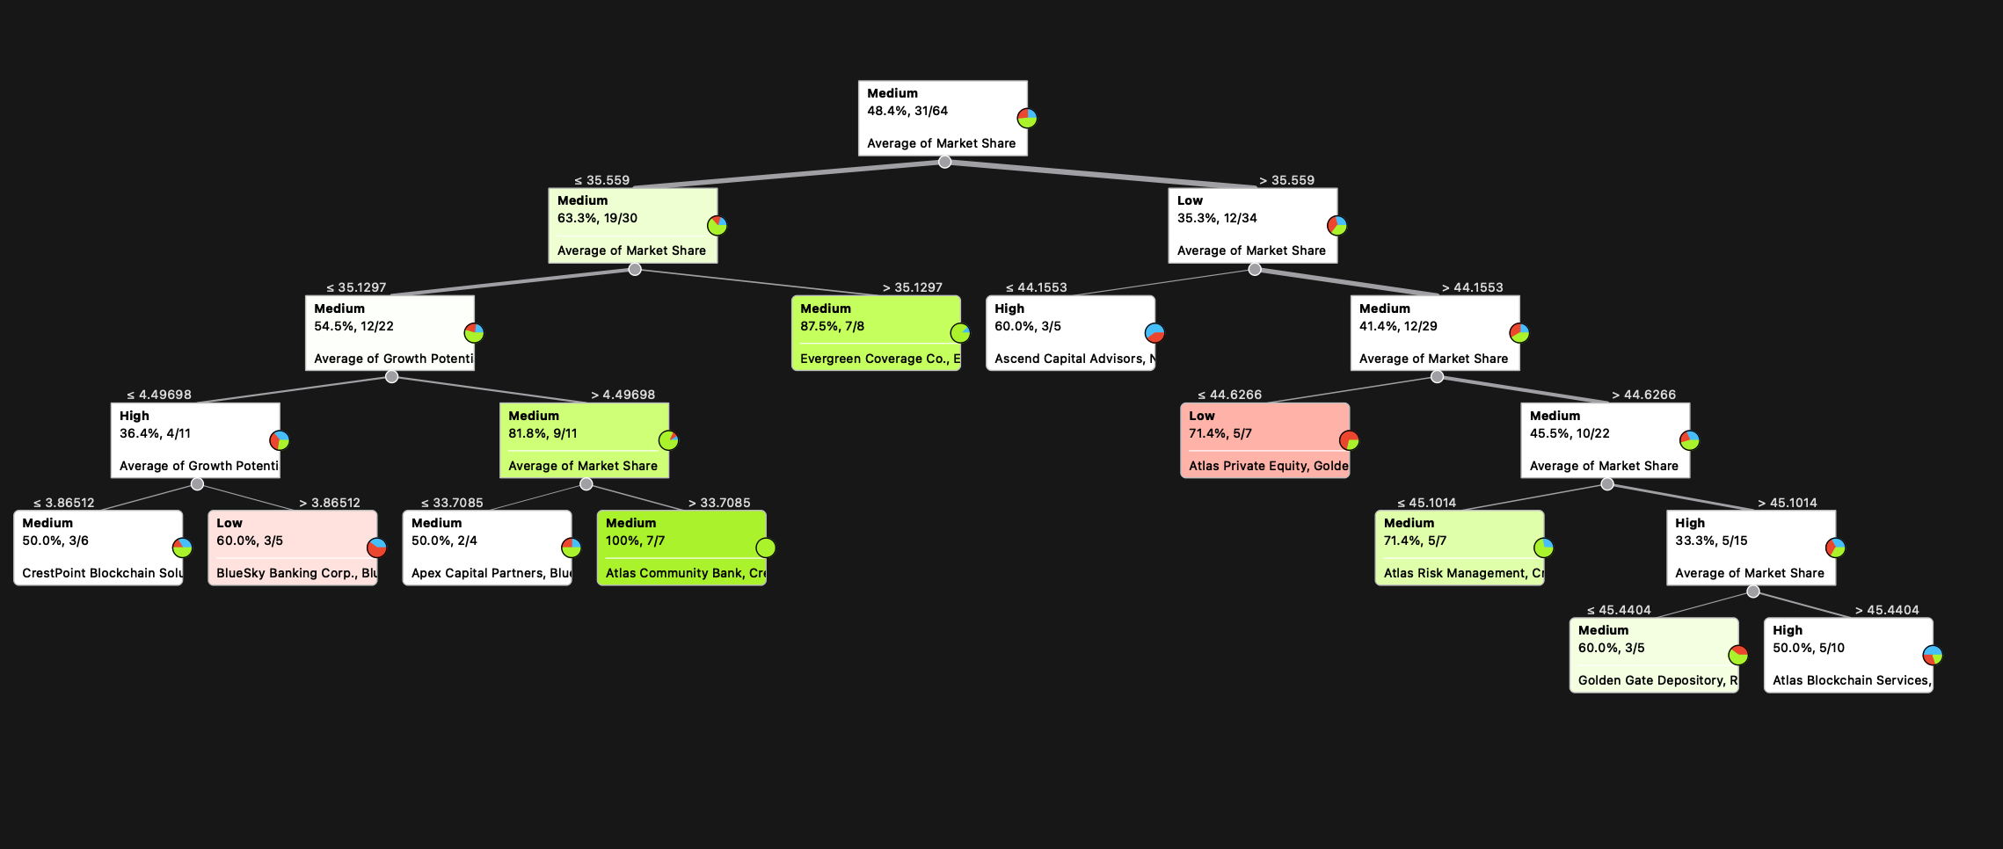
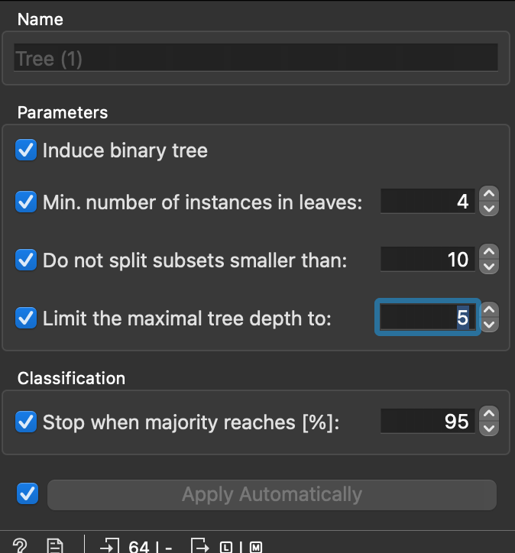
Classification - Stock Price by CG Factors
Classification Tree
Classification Settings

Slide 11
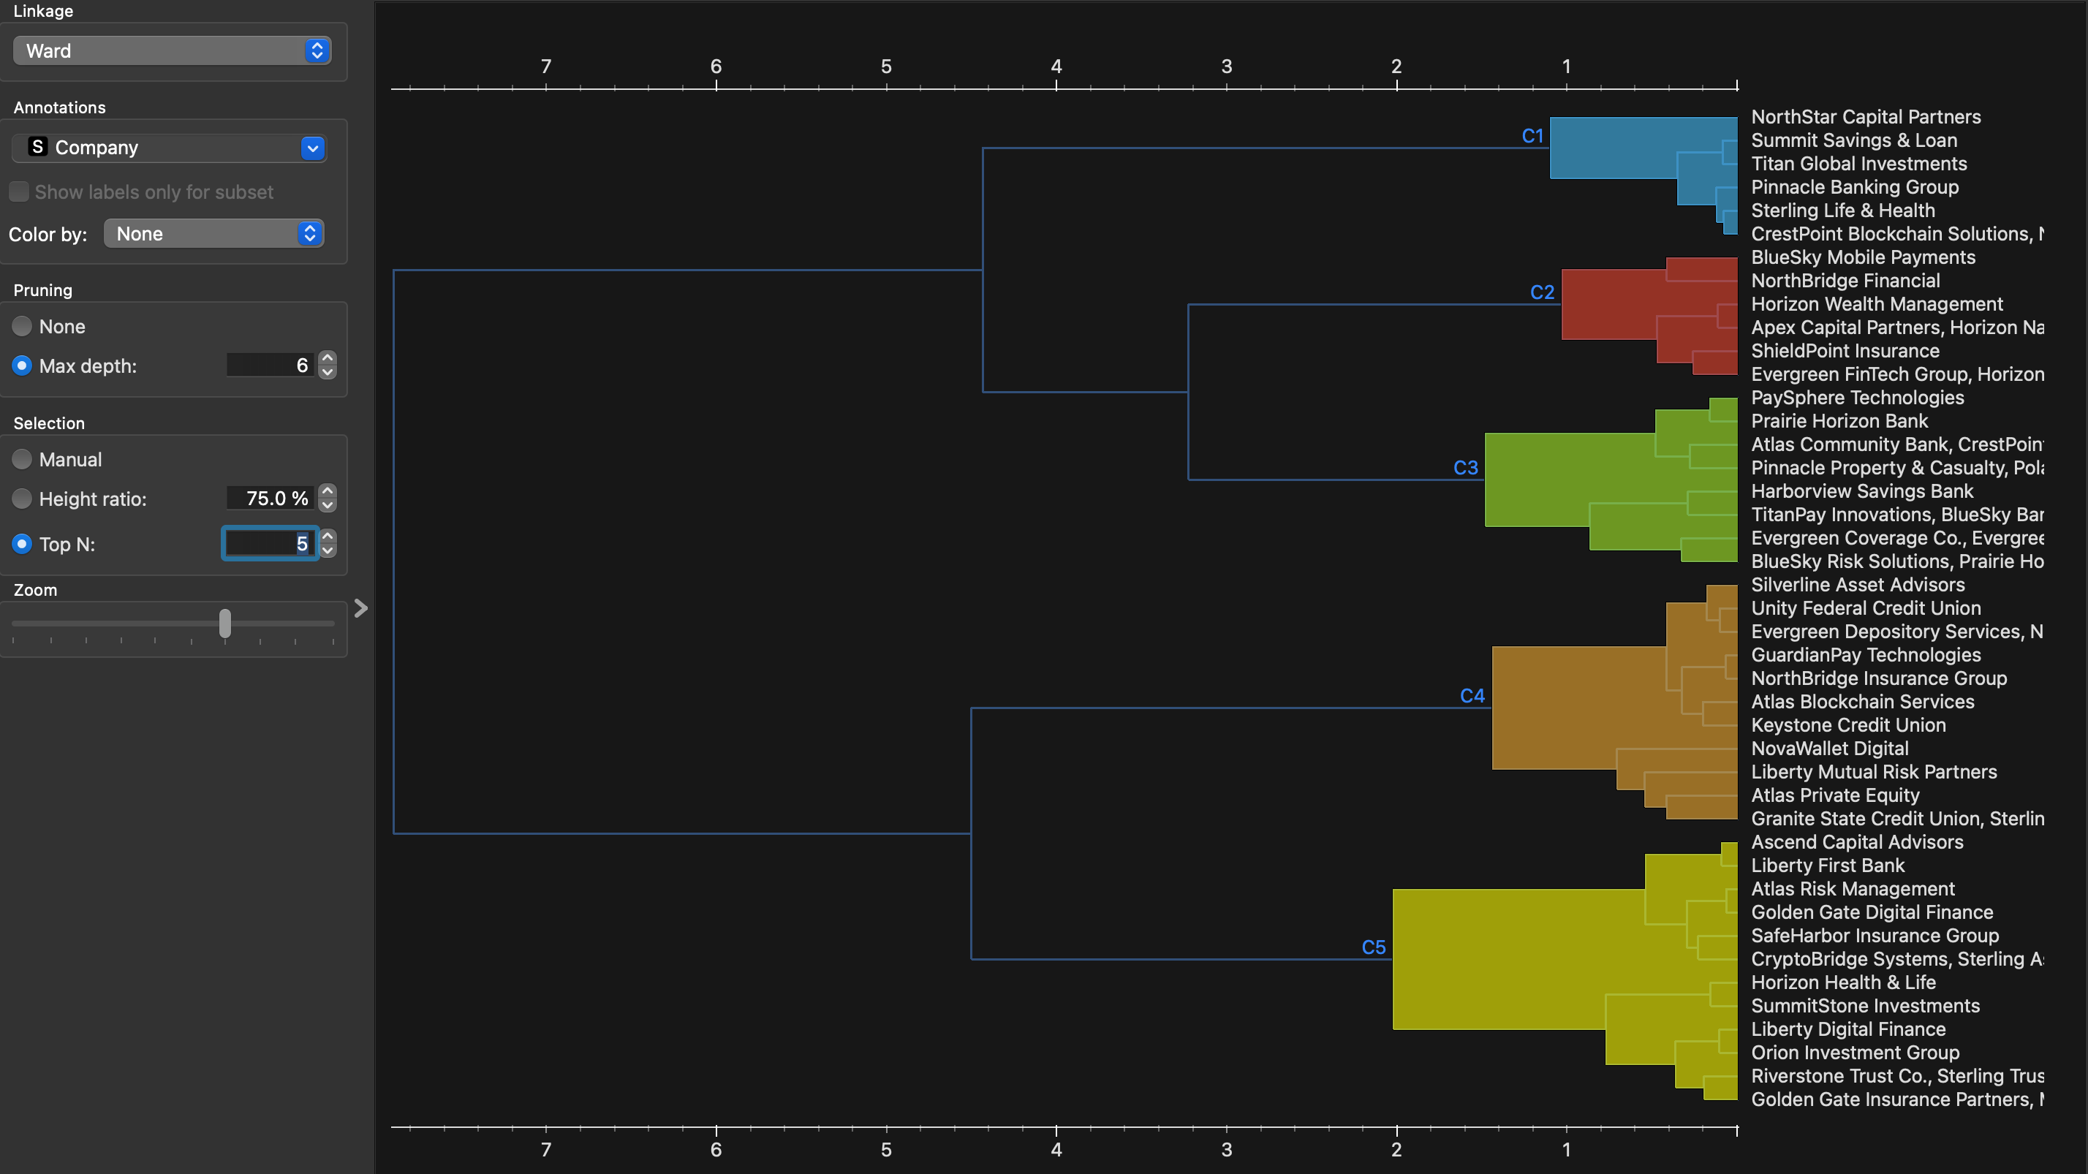
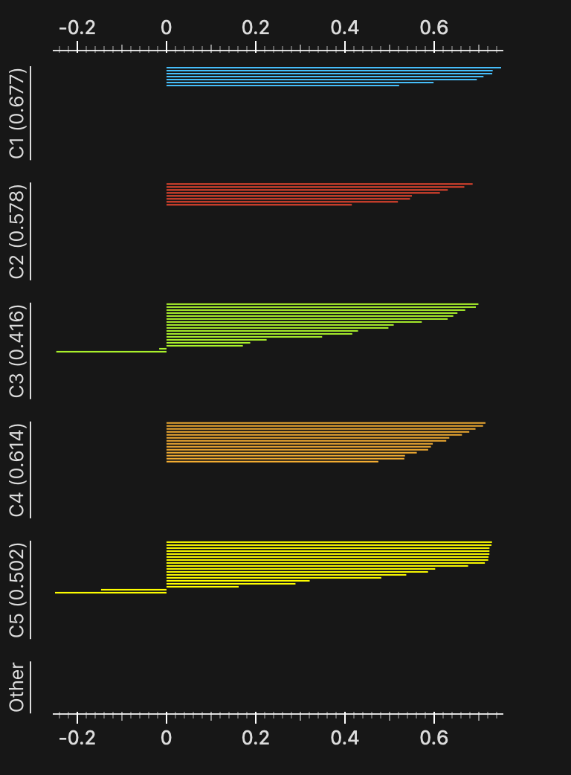
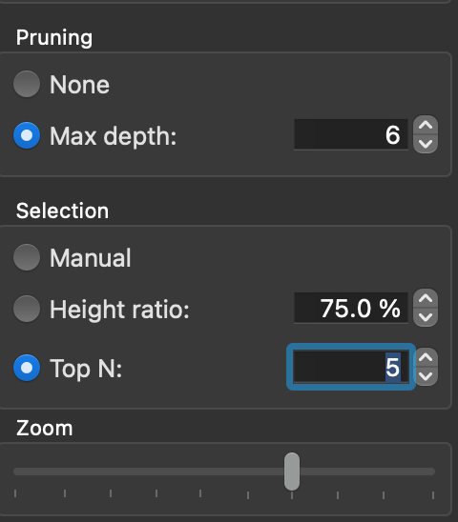
Hierarchical Clustering
Hierarchical Clusters
Silhouette Plot
Record the setting values used below :
Record the Cluster Number and Silhouette Score in the table provided (add more lines if needed)
Cluster Number | Silhouette Score
1 | .677
2 | .578
3 | .416
4 | .614
5 | .502

Slide 12
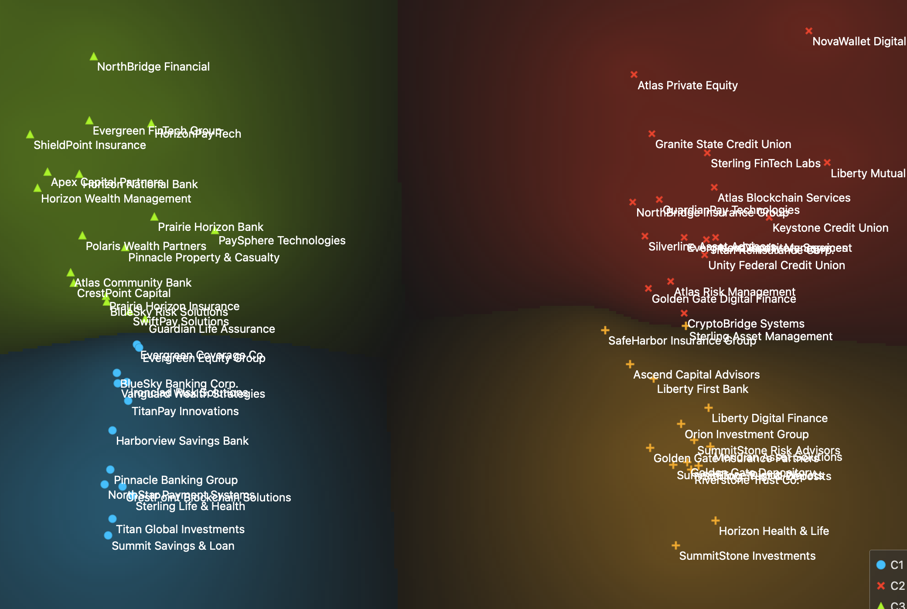
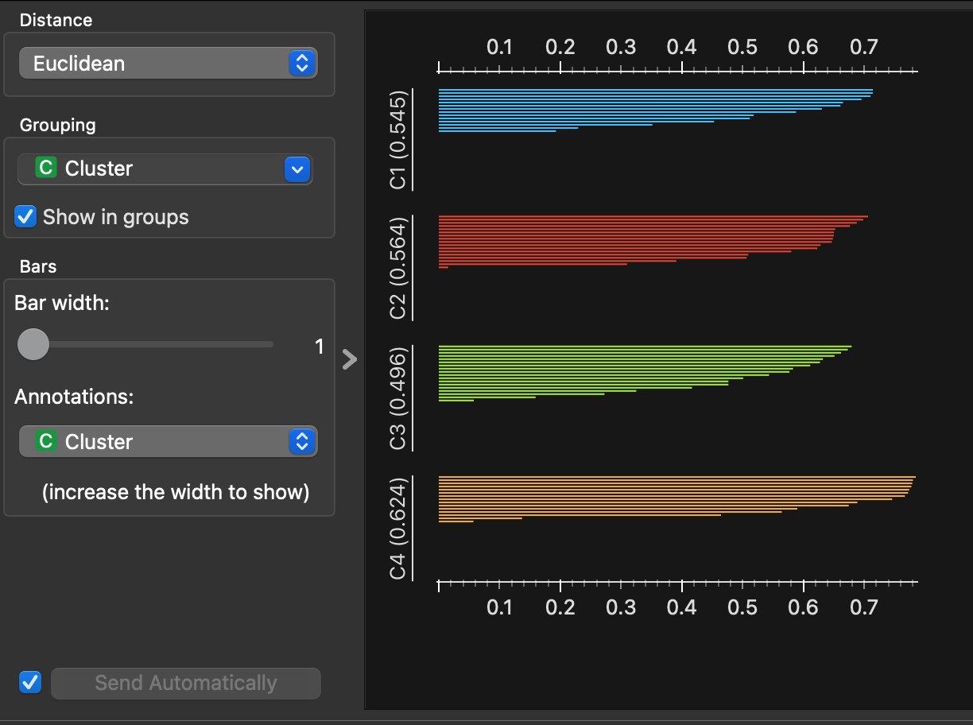
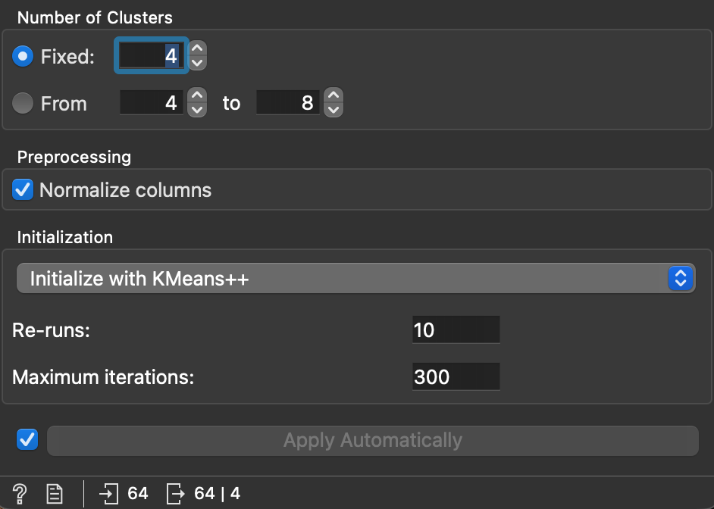
K-Means Clustering
K-Means Clusters
Silhouette Plot
Record the setting values used below :
Record the Cluster Number and Silhouette Score in the table provided (add more lines if needed)
Cluster Number | Silhouette Score
1 | .545
2 | .564
3 | .496
4 | .624
5

Slide 13
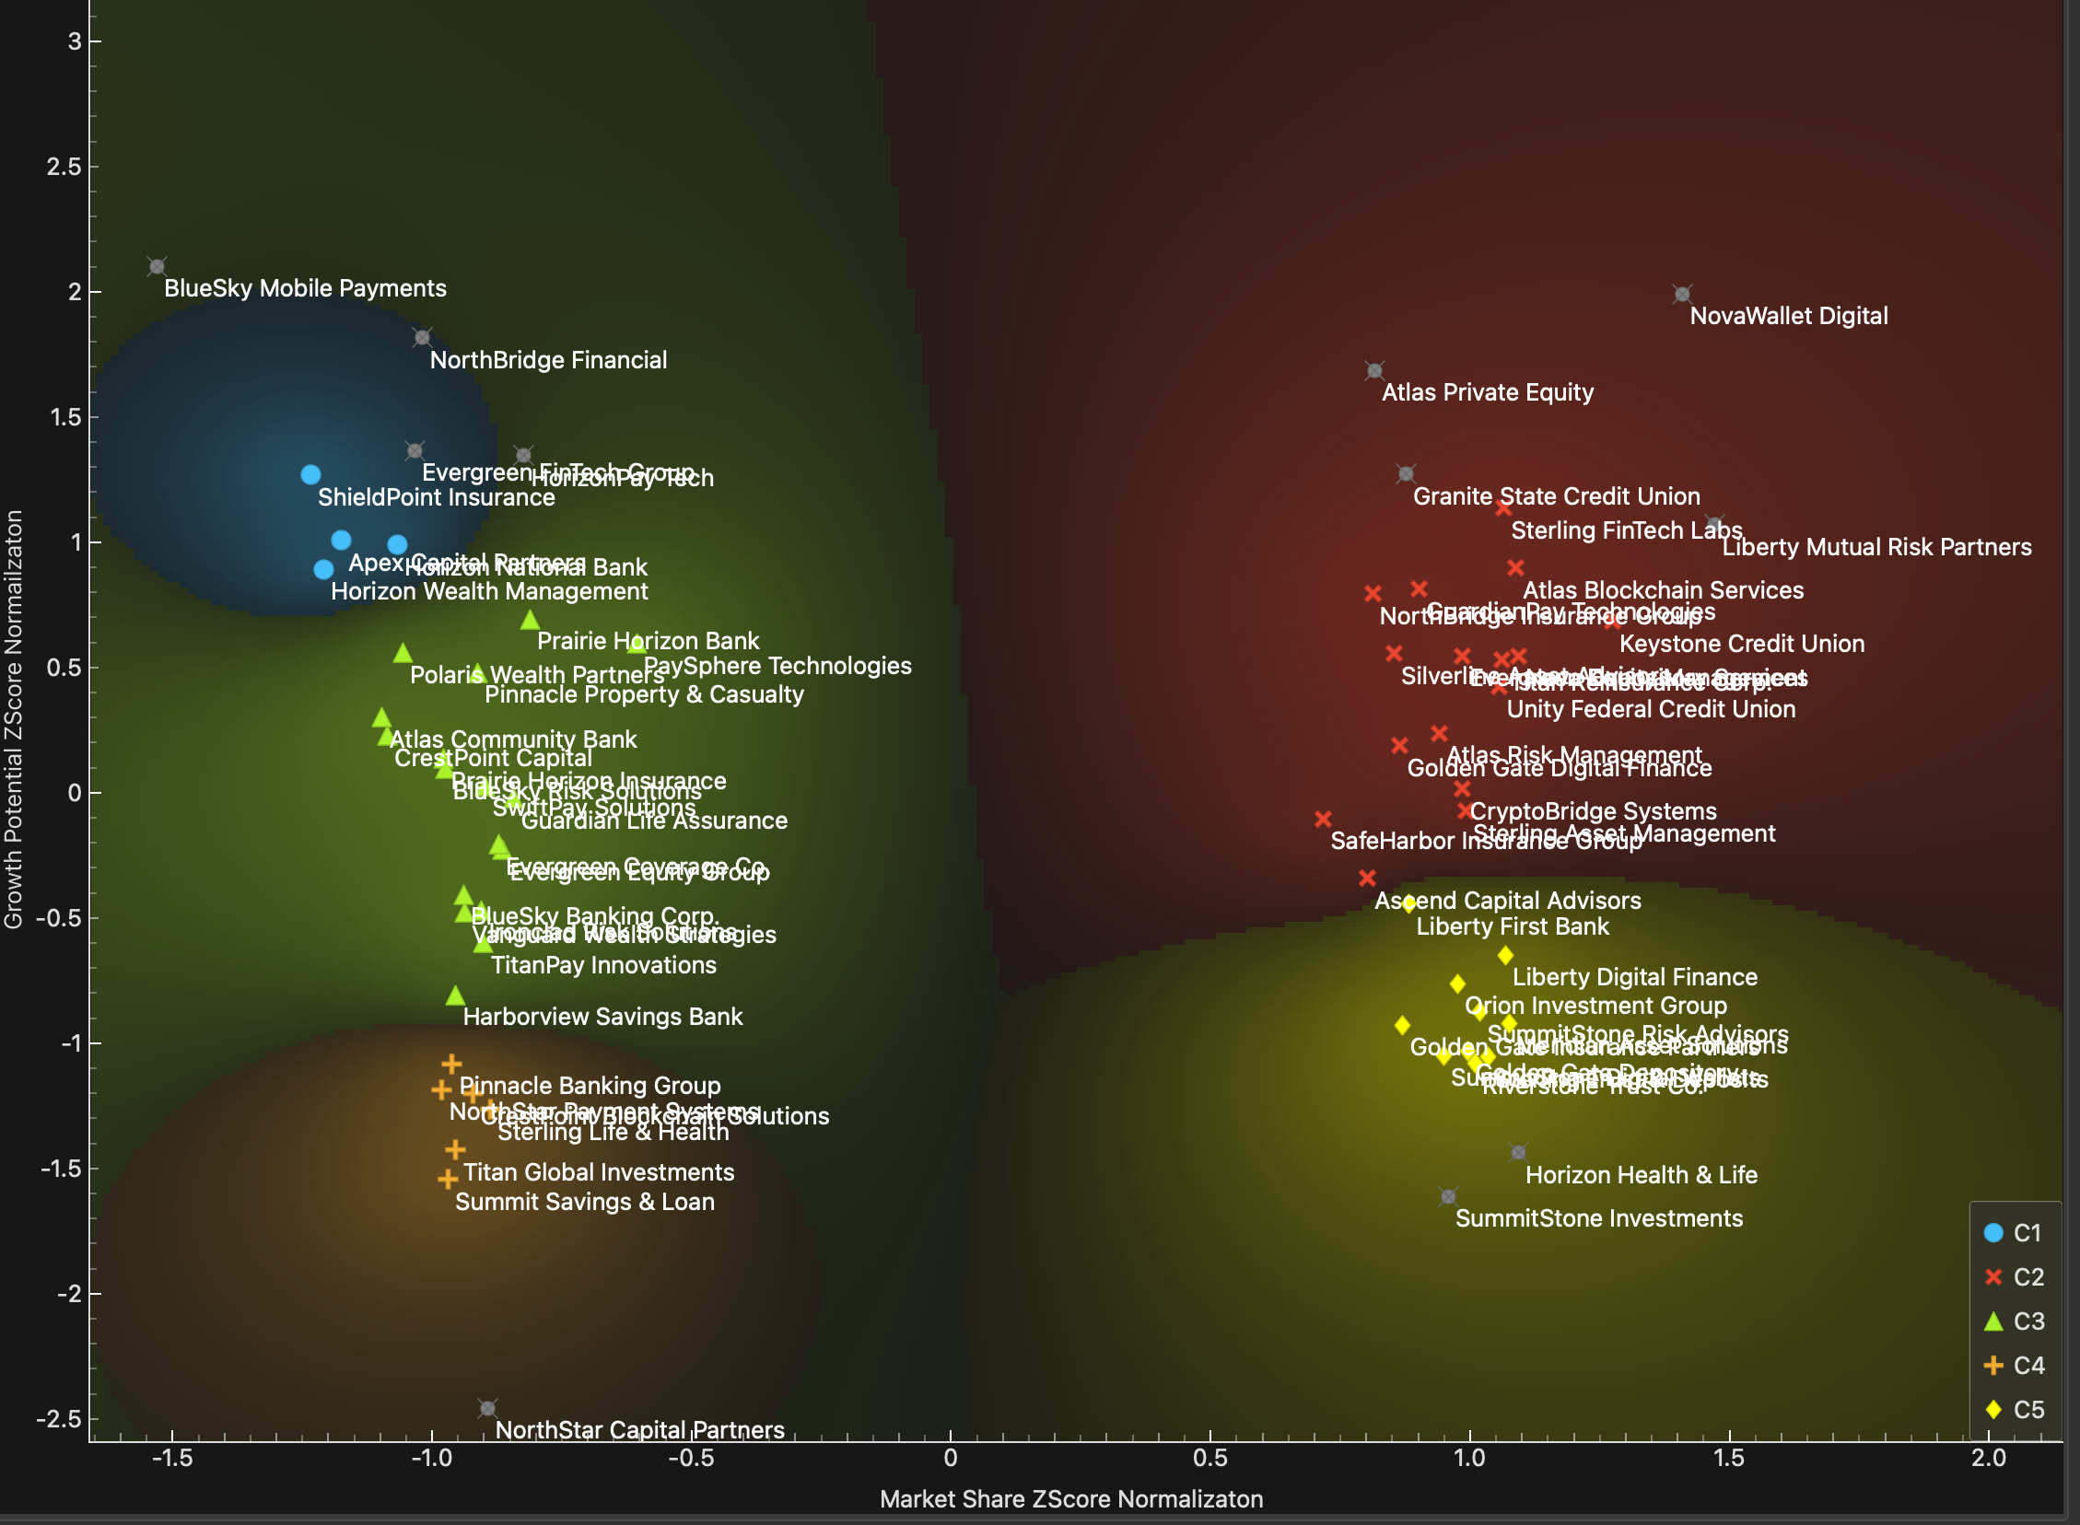
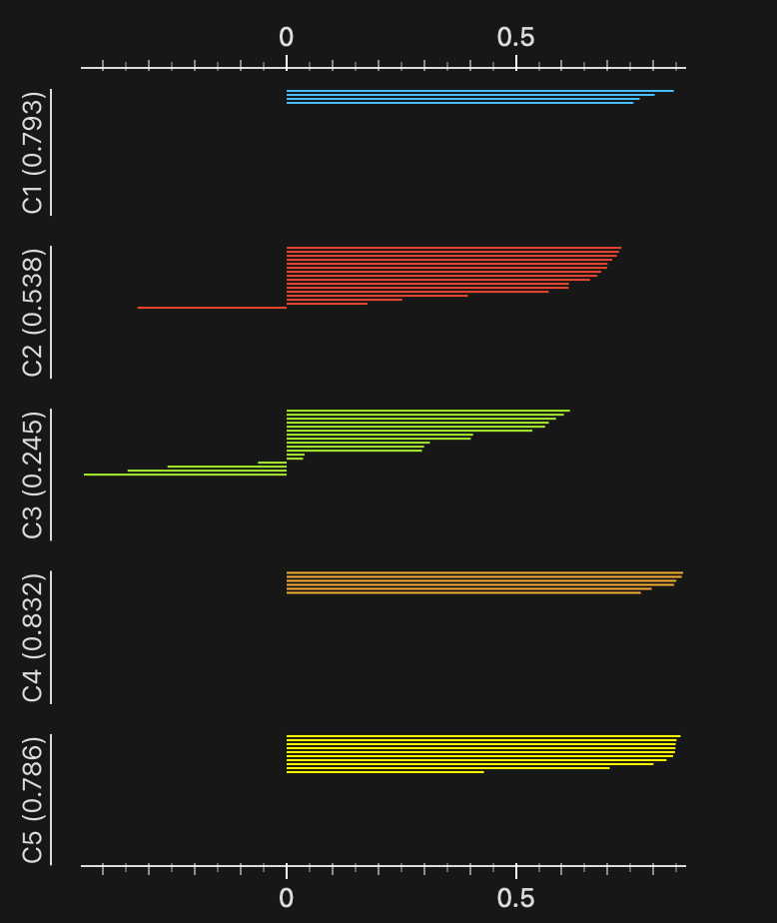
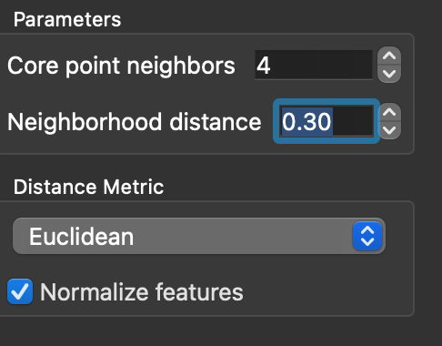
DBSCAN
DBSCAN Clusters
Silhouette Plot
Record the setting values used below :
Record the Cluster Number and Silhouette Score in the table provided (add more lines if needed)
Cluster Number | Silhouette Score
1 | .793
2 | .538
3 | .245
4 | .832
5 | .786

Slide 14
Information Development
The clustering that resulted in the highest silhouette score would be the K means clustering, which just so happened to separate the data into the perfect share growth matrix for discovering which businesses to invest in. The first decision tree comes to the conclusion that very powerful companies that don’t have much growth potential struggle to find customer satisfaction. The second tree says that high profit companies will only be a medium profit because of the high costs, where as the medium profits can produce higher profit share because of their need to be very cost effective
Analysis Outcomes
Data Review
Data Issue Summary

Slide 15
Outcome Communication
Using the Boston Consulting Group Growth Share Matrix Classifications which 16 companies (4 from each classification)would you advise investors to build a portfolio from the 60 company profiles provided?
Messaging (90 to 180 words)
A well constructed portfolio should combine today’s stars with some of the rising contenders to ensure both current success along with sustained upside. From the top right quadrant, companies like NovaWallet Digital, Atlas Private Equity and Granite State Credit Union demonstrate very strong momentum and will anchor your portfolio. TO avoid relying solely on the stars of today, emerging stars like NorthBridge Financial and BlueSky Mobile Payments offer good upside for the future because of the high growth factor. Stable high share firms like Horizon Health & Life and Liberty Mutual Risk partners provide dependable performance and will smooth out any volatility in the future. Finally, Value Oriented opportunities like NorthStar Capital Partners and Titan Global introduce a new type of upside. Although these companies are low growth and low share, they may be able to rebound due to their customer satisfaction levels. Together, these 16 will create a diversified and forward looking investment mix
Answering the Specific Questions
Report formation
Messaging
16 Companies
Atlas Private Equity
Granite State Credit Union
Sterling FinTech Labs
NovaWallet Digital
Horizon Health & Life
SummitStone Investments
NorthStar Payment Systems
Liberty Mutual Risk Partners
NorthBridge Financial
ShieldPoint Insurance
Evergreen FinTech Group
BlueSky Mobile Payments
Titan Global Investments
Summit Savings & Loan
Sterling Life & Health
NorthStar Capital Partners

